Slide 1
Unit-2
By
T.Jalaja
CSE Dept, VCE

Slide 2
Singleton class
A singleton class is a class that can have only one object (an instance of the class) at a time.
After first time, if we try to instantiate the Singleton class, the new variable also points to the first instance created.
It’s purpose is to control object creation, limiting the number of objects to only one.
Since there is only one Singleton instance, any instance fields of a Singleton will occur only once per class, just like static fields.
Singletons often control access to resources, such as database connections or sockets.

Slide 3
Singleton class
Eg: if you have a license for only one connection for your database or your JDBC driver has trouble with multithreading, the Singleton makes sure that only one connection is made or that only one thread can access the connection at a time.
There are two forms of singleton class design
Early Instantiation: creation of instance at load time.
Lazy Instantiation: creation of instance when required.
Advantage
Saves memory because object is not created at each request. Only single instance is reused again and again.
Usage of Singleton
Singleton pattern is mostly used in multi-threaded and database applications. It is used in logging, caching, thread pools, configuration settings etc.

Slide 4
Singleton class
Early Instantiation :
we create the instance of the class at the time of declaring the static data member, so instance of the class is created at the time of classloading.
public class A{
private static A obj=new A();//Early, instance will be created
private A(){}
public static A getA(){
return obj;
}
public void doSomething(){
System.out.println(“ Method od singleton class”);
}
}

Slide 5
Singleton class
public class SingletonDemo {
public static void main(String[] args) {
A tmp = A.getA( );
tmp. doSomething( );
}
}

Slide 6
Singleton class
lazy Instantiation:
we create the instance of the class is created when required.
public class A{
private static A obj=null;
Public String s;
private A(){ s=“hello”;}
public static A getA(){
if (obj == null){
obj = new A();//instance will be created at request time
}
return obj;
}
public void display(){
System.out.println(s);
}}

Slide 7
Singleton class
public class SingletonDemo {
public static void main(String[] args) {
A tmp = A.getA( );
tmp. display( );
}
}
create a private constructor that restricts to create an object outside of the class
create a private attribute that refers to the singleton object.
create a public static method that allows us to create and access the object we created. Inside the method, we will create a condition that restricts us from creating more than one object.

Slide 8
Singleton class
class Database {
private static Database dbObject;
private Database() { }
public static Database getInstance() {
if(dbObject == null) { dbObject = new Database(); }
return dbObject;
}
public void getConnection() {
System.out.println("You are now connected to the database.");
}
}
class Main {
public static void main(String[] args) { Database db1;
db1= Database.getInstance();
db1.getConnection(); } }

Slide 9
Abstract Class
There are situations in which you will want to define a superclass that declares the structure of a given abstraction without providing a complete implementation of every method. Such a class determines the nature of the methods that the subclasses must implement.
To declare an abstract method, use this general form:
abstract type name(parameter-list);
No method body is present.

Slide 10
Abstract Class
Any class that contains one or more abstract methods must also be declared abstract.
To declare a class abstract, use the abstract keyword in front of the class keyword at the beginning of the class declaration.
There can be no objects of an abstract class. That is, an abstract class cannot be directly instantiated with the new operator.
Such objects would be useless, because an abstract class is not fully defined.
Also, you cannot declare abstract constructors, or abstract static methods.
Any subclass of an abstract class must either implement all of the abstract methods in the superclass, or be declared abstract itself.

Slide 11
Using Abstract Classes
abstract class A {
abstract void callme();
classes void callmetoo() {
System.out.println("This is a concrete method.");
}}
class B extends A {
void callme() {
System.out.println("B's implementation of callme.");
}}
class AbstractDemo {
public static void main(String args[]) {
B b = new B();
b.callme();
b.callmetoo();
}}

Slide 12
Using Abstract Classes
Although abstract classes cannot be used to instantiate objects, they can be used to create object references, because Java’s approach to run-time polymorphism is implemented through the use of superclass references.
Thus, it must be possible to create a reference to an abstract class so that it can be used to point to a subclass object.

Slide 13
Using Abstract Classes
abstract class Figure {
double dim1;
double dim2;
Figure(double a, double b) {
dim1 = a;
dim2 = b;
}
// area is now an abstract method
abstract double area();
}
class Rectangle extends Figure {
Rectangle(double a, double b) {
super(a, b);
}

Slide 14
Using Abstract Classes
// override area for rectangle
double area() {
System.out.println("Inside Area for Rectangle.");
return dim1 * dim2;
}
}
class Triangle extends Figure {
Triangle(double a, double b) {
super(a, b);
}
double area() {
System.out.println("Inside Area for Triangle.");
return dim1 * dim2 / 2;
}}

Slide 15
Using Abstract classes
class AbstractAreas {
public static void main(String args[]) {
// Figure f = new Figure(10, 10); // illegal now
Rectangle r = new Rectangle(9, 5);
Triangle t = new Triangle(10, 8);
Figure figref; // this is OK, no object is created
figref = r;
System.out.println("Area is " + figref.area());
figref = t;
System.out.println("Area is " + figref.area());
}
}

Slide 16
Nested Class
It is possible to define a class within another class; such classes are known as nested classes.
The scope of a nested class is bounded by the scope of its enclosing class. Thus, if class B is defined within class A, then B does not exist independently of A .
A nested class has access to the members, including private members, of the class in which it is nested.
However, the enclosing class does not have access to the members of the nested class.
The most important type of nested class is the inner class
An inner class is a non-static nested class. It has access to all of the variables and methods of its outer class

Slide 17
Nested Class
class Outer {
int outer_x = 100;
void test() {
Inner inner = new Inner();
inner.display();
}
// this is an inner class
class Inner {
void display() {
System.out.println("display: outer_x = " + outer_x);
}
}
}

Slide 18
Nested Class
class InnerClassDemo {
public static void main(String args[]) {
Outer outer = new Outer();
outer.test();
}
}
Output from this application is shown here:
display: outer_x = 100
// an instance of Inner can be created only in the context of class Outer.

Slide 19
Nested Class
Members of the inner class are known only within the scope of the inner class and may not be used by the outer class.
class Outer {
int outer_x = 100;
void test() {
Inner inner = new Inner();
inner.display();
}
class Inner {
int y = 10; // y is local to Inner
void display() {
System.out.println("display: outer_x = " + outer_x);
}}
void showy() {
System.out.println(y); // error, y not known here!
}}

Slide 20
Nested Class
//Compilation Error
class InnerClassDemo {
public static void main(String args[]) {
Outer outer = new Outer();
outer.test();
}
}
It is possible to define inner classes within any block scope.

Slide 21
Nested Class
//Define an inner class within a for loop.
class Outer {
int outer_x = 100;
void test() {
for(int i=0; i<10; i++) {
class Inner {
void display() {
System.out.println("display: outer_x = " + outer_x);
}
}
Inner inner = new Inner();
inner.display();
}
}
}

Slide 22
Nested Class
class InnerClassDemo {
public static void main(String args[]) {
Outer outer = new Outer(); outer.test();
}}
Output
display: outer_x = 100
display: outer_x = 100
display: outer_x = 100
display: outer_x = 100
display: outer_x = 100
display: outer_x = 100
display: outer_x = 100
display: outer_x = 100
display: outer_x = 100
display: outer_x = 100

Slide 23
Nested Class
Inner classes are particularly helpful when handling events.
anonymous inner classes, which are inner classes that don’t have a name.
A class that have no name is known as anonymous inner class in java.
It should be used if you have to override method of class or interface.
Java Anonymous inner class can be created by two ways:
Class (may be abstract or concrete).
Interface

Slide 24
Packages
Packages are containers for classes.
They are used to keep the class name space compartmentalized.
For example, a package allows you to create a class named List, which you can store in your own package without concern that it will collide with some other class named List stored elsewhere.
Packages are stored in a hierarchical manner and are explicitly imported into new class definitions.
Till now we have seen that a unique name had to be used for each class to avoid name collisions.

Slide 25
Packages
Java provides a mechanism for partitioning the class name space into more manageable chunks.
This mechanism is the package.
The package is both a naming and a visibility control mechanism.
You can define classes inside a package that are not accessible by code outside that package.
You can also define class members that are exposed only to other members of the same package.
This allows your classes to have intimate knowledge of each other, but not expose that knowledge to the rest of the world.

Slide 26
Packages
Defining a Package
Include a package command as the first statement in a Java source file.
Any classes declared within that file will belong to the specified package. The package statement defines a name space in which classes are stored.
If you omit the package statement, the class names are put into the default package, which has no name.
Default package is fine for short, sample programs, it is inadequate for real applications.
This is the general form of the package statement:
package pkg;

Slide 27
Packages
Java uses file system directories to store packages. For example, the .class files for any classes you declare to be part of MyPackage must be stored in a directory called MyPackage.
More than one file can include the same package statement.
The general form of a multileveled package statement is shown here:
package pkg1[.pkg2[.pkg3]];
Eg: package java.awt.image;
//needs to be stored in java\awt\image in a Windows environment.
package MyPack;
In order for a program to find MyPack, the program can be executed from a directory immediately above MyPack,

Slide 28
Packages
package MyPack;
class Balance {
String name; double bal;
Balance(String n, double b) {
name = n;
bal = b;
}
void show() {
if(bal<0)
System.out.print("--> ");
System.out.println(name + ": $" + bal);
}
}

Slide 29
Packages
class AccountBalance {
public static void main(String args[]) {
Balance current[] = new Balance[3];
current[0] = new Balance("K. J. Fielding", 123.23);
current[1] = new Balance("Will Tell", 157.02);
current[2] = new Balance("Tom Jackson", -12.33);
for(int i=0; i<3; i++)
current[i].show();
}}

Slide 30
Packages
Call this file AccountBalance.java and put it in a directory called MyPack.
Next, compile the file. Make sure that the resulting .class file is also in the MyPack directory.
Then, try executing the AccountBalance class, using the following command line:
java MyPack.AccountBalance
Remember, you will need to be in the directory above MyPack when you execute this command.

Slide 31
Packages
Access Protection
Java provides many levels of protection to allow fine-grained control over the visibility of variables and methods within classes, subclasses, and packages.
Packages act as containers for classes and other subordinate packages.
Classes act as containers for data and code.
The class is Java’s smallest unit of abstraction.
Because of the interplay between classes and packages, Java addresses four categories of visibility for class members:
Subclasses in the same package
Non-subclasses in the same package
Subclasses in different packages
Classes that are neither in the same package nor subclasses

Slide 32
Packages
The three access modifiers, private, public, and protected, provide a variety of ways to produce the many levels of access required by these categories.
Anything declared public can be accessed from anywhere.
Anything declared private cannot be seen outside of its class.
When a member does not have an explicit access specification, it is visible to subclasses as well as to other classes in the same package. This is the default access.
If you want to allow an element to be seen outside your current package, but only to classes that subclass your class directly, then declare that element protected.

Slide 33
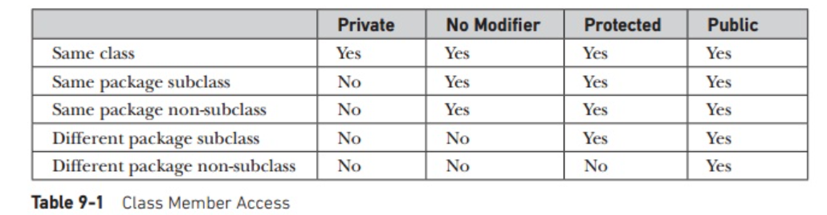
Packages
Table 9-1 applies only to members of classes.
A non-nested class has only two possible access levels: default and public.
When a class is declared as public, it is accessible by any other code.
If a class has default access, then it can only be accessed by other code within its same package.
When a class is public, it must be the only public class declared in the file, and the file must have the same name as the class.

Slide 34
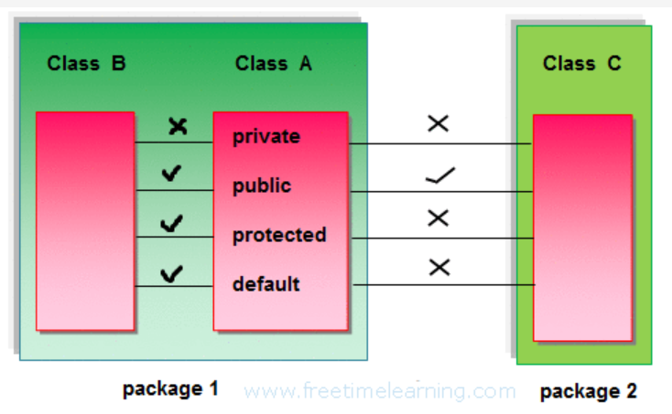
Packages

Slide 35
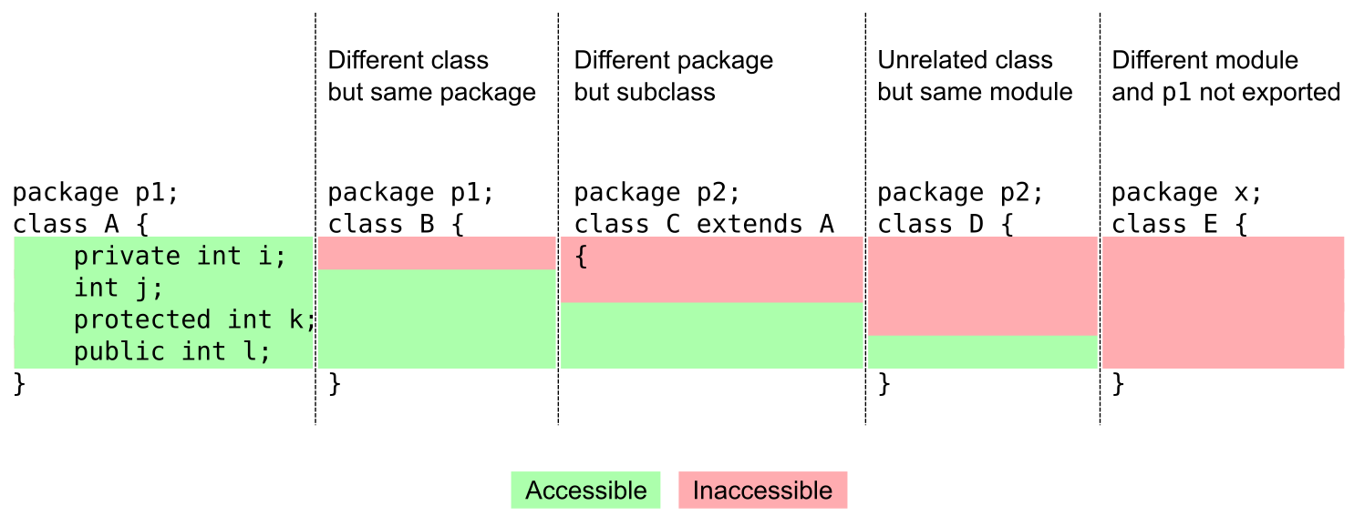
Packages

Slide 36
Packages
Importing Packages
There are no core Java classes in the unnamed default package; all of the standard classes are stored in some named package.
Since classes within packages must be fully qualified with their package name or names.
For this reason, Java includes the import statement to bring certain classes, or entire packages, into visibility.
In a Java source file, import statements occur immediately following the package statement (if it exists) and before any class definitions. This is the general form of the import statement:
import pkg1 [.pkg2].(classname | *);
Eg:
import java.util.Date;
import java.io.*;

Slide 37
Packages
It must be emphasized that the import statement is optional.
Any place you use a class name, you can use its fully qualified name, which includes its full package hierarchy.
For example, this fragment uses an import statement:
import java.util.*;
class MyDate extends Date {
}
The same example without the import statement looks like this:
class MyDate extends java.util.Date {
}

Slide 38
Interfaces
Using the keyword interface, you can fully abstract a class’ interface from its implementation.
That is, using interface, you can specify what a class must do, but not how it does it.
Interfaces are syntactically similar to classes, but they lack instance variables, and their methods are declared without any body.
Once it is defined, any number of classes can implement an interface.
Also, one class can implement any number of interfaces.
By providing the interface keyword, Java allows you to fully utilize the “one interface, multiple methods” aspect of polymorphism.

Slide 39
Interfaces
Defining an Interface
An interface is defined much like a class. This is a simplified general form of an interface:
access interface name {
return-type method-name1(parameter-list);
return-type method-name2(parameter-list);
type final-varname1 = value;
type final-varname2 = value; //...
return-type method-nameN(parameter-list);
type final-varnameN = value;
}

Slide 40
Interfaces
The interface must be the only public interface declared in the file, and the file must have the same name as the interface.
Each class that includes such an interface must implement all of the methods.
// Beginning with JDK 8, it is possible to add a default implementation to an interface method.
Variables can be declared inside of interface declarations. They are implicitly final and static, meaning they cannot be changed by the implementing class. They must also be initialized.
All methods and variables are implicitly public.
Eg:
interface Callback {
void callback(int param);
}

Slide 41
Interfaces
Implementing Interfaces
To implement an interface, include the implements clause in a class definition, and then create the methods required by the interface.
class classname [extends superclass] [implements interface [,interface...]] { // class-body
}
Eg:
class Client implements Callback {
public void callback(int p) {
System.out.println("callback called with " + p);
}}

Slide 42
Interfaces
It is both permissible and common for classes that implement interfaces to define additional members of their own.
class Client implements Callback {
public void callback(int p) {
System.out.println("callback called with " + p);
}
void nonIfaceMeth() {
System.out.println("Classes that implement interfaces " + "may also define other members, too.");
}
}

Slide 43
Interfaces
Accessing Implementations Through Interface References
class TestIface {
public static void main(String args[]) {
Callback c = new Client();
c.callback(42);
}}
Although c can be used to access the callback( ) method, it cannot access any other members of the Client class.
An interface reference variable has knowledge only of the methods declared by its interface declaration.

Slide 44
Interfaces
Partial Implementations
If a class includes an interface but does not fully implement the methods required by that interface, then that class must be declared as abstract.
abstract class Incomplete implements Callback {
int a, b;
void show() {
System.out.println(a + " " + b);
}
//...
}

Slide 45
Interfaces
Nested Interfaces
An interface can be declared a member of a class or another interface. Such an interface is called a member interface or a nested interface.
class A {
public interface NestedIF {
boolean isNotNegative(int x);
}}
// B implements the nested interface.
class B implements A.NestedIF {
public boolean isNotNegative(int x) {
return x < 0 ? false: true;
}}

Slide 46
Interfaces
Eg: REFER TEXT BOOK AND EXECUTE THE COMPLETE PROGRAM
interface IntStack {
void push(int item); // store an item
int pop(); // retrieve an item
}

Slide 47
Interfaces
Variables in Interfaces
import java.util.Random;
interface SharedConstants { int NO = 0;
int YES = 1; int MAYBE = 2; int LATER = 3; int SOON = 4;
int NEVER = 5;
}
class Question implements SharedConstants {
Random rand = new Random();
int ask() {
int prob = (int) (100 * rand.nextDouble());
if (prob < 30)
return NO; // 30%
else if (prob < 60)
return YES; }}

Slide 48
Interfaces
Interfaces Can Be Extended
One interface can inherit another by use of the keyword extends.
When a class implements an interface that inherits another interface, it must provide implementations for all methods required by the interface inheritance chain.
interface A {
void meth1();
void meth2();
}
interface B extends A {
void meth3();
}

Slide 49
Interfaces
//This class must implement all of A and B
class MyClass implements B {
public void meth1() {
System.out.println("Implement meth1().");
}
public void meth2() {
System.out.println("Implement meth2().");
}
public void meth3() {
System.out.println("Implement meth3().");
}
}

Slide 50
Interfaces
class IFExtend {
public static void main(String arg[]) {
MyClass ob = new MyClass();
ob.meth1();
ob.meth2();
ob.meth3();
}
}

Slide 51
Interfaces
1.Can a class extend another class?
2.Can a interface extend another interface?
3.Can a class implement another interface?
4.Can a class extend more than one class?
5.Can a class implement more than one interface?
extends
implements

Slide 52
End
Thank you…

